Slide 1


An AI-Driven Autonomous DevOps Framework for Intelligent Cloud Infrastructure Provisioning and Application Deployment
Batch Number:
Name of the Team Members | Roll Numbers
G. Vibhas Naidu | 23071A67F1
Jagadeeswar Jonnadula | 23071A67F4
K Parvez Alam | 23071A67F5
Y. Uday Bhaskar Reddy | 23071A67K4
Under The Supervision of:
Name: Dr. P Jyothi
Designation: Assistant Professor
Dept. of CSE-(CyS, DS) and AI&DS

Slide 2

Abstract:
Modern software development requires efficient, scalable, and reliable cloud deployment, but developers often face challenges in analyzing application requirements, selecting suitable cloud services, configuring infrastructure, managing CI/CD pipelines, and identifying deployment or runtime failures. This project proposes an AI-Driven Autonomous DevOps Framework for Intelligent Cloud Infrastructure Provisioning and Application Deployment that integrates Artificial Intelligence, Machine Learning, Large Language Models, Natural Language Processing, and cloud automation into a unified platform. The system enables developers to connect external code repositories such as GitHub, after which an ML-based code analysis model analyzes the source code to identify the programming language, framework, dependencies, architecture, and infrastructure requirements. Based on these characteristics, an ML-driven cloud-service recommendation model recommends suitable services and deployment strategies across AWS, Microsoft Azure, and Google Cloud Platform (GCP) by considering application requirements, cost, performance, scalability, and resource utilization. A decision and rule layer allows users to enforce deployment preferences, such as selecting a specific cloud provider or choosing the most cost-effective option.
The framework also incorporates an LLM-based application intelligence module to provide context-specific insights about the codebase, architecture, dependencies, functionality, and deployment requirements. Terraform and cloud provider APIs are used to automatically provision the selected infrastructure and deploy applications through CI/CD pipelines. The system generates an explainable deployment report describing the selected cloud resources, their purpose, configuration, and the reasoning behind deployment decisions. For operational reliability, an ML-based monitoring and anomaly detection model analyzes application and infrastructure metrics and logs to identify abnormal behavior, while an ML-based error classification model identifies deployment and runtime failures and predicts their probable causes. A rule-based automation engine can initiate corrective actions such as application restart, scaling, rollback, or redeployment. By combining Machine Learning, Artificial Intelligence, Natural Language Processing, Infrastructure as Code, and multi-cloud automation, the proposed framework aims to reduce manual DevOps effort, improve deployment reliability, optimize cloud-resource selection, and enable intelligent, autonomous, and explainable application deployment across heterogeneous cloud environments.
Keywords:
Artificial Intelligence, Machine Learning, Cloud Computing, DevOps Automation, Multi-Cloud Deployment, Infrastructure as Code, CI/CD, Anomaly Detection.

Slide 3
Introduction:
Cloud computing and DevOps have become essential technologies in modern software development, enabling organizations to develop, deploy, and scale applications efficiently. However, cloud application deployment involves several complex activities, such as analyzing application requirements, identifying dependencies, selecting appropriate cloud services, configuring infrastructure, establishing CI/CD pipelines, and managing deployment issues. These activities often depend on manual effort and specialized technical knowledge. The complexity increases further when applications need to be deployed across multiple cloud platforms with different services, configurations, and resource requirements. Therefore, there is a need for intelligent approaches that can assist developers in making effective deployment and infrastructure decisions.
The proposed AI-Driven Autonomous DevOps Framework for Intelligent Cloud Infrastructure Provisioning and Application Deployment addresses these challenges by integrating Artificial Intelligence, Machine Learning, Natural Language Processing, cloud computing, and DevOps technologies. The framework analyzes application source code to identify its characteristics, dependencies, architecture, and infrastructure requirements, and uses ML-based models to recommend suitable cloud services and deployment strategies. It also incorporates cloud resource provisioning, CI/CD pipelines, application monitoring, anomaly detection, and error classification to support different stages of the deployment lifecycle. By combining intelligent decision-making with multi-cloud technologies, the proposed framework aims to improve deployment efficiency, reliability, scalability, and cost-effectiveness, while reducing the complexity and technical effort involved in cloud application deployment.

Slide 4
Literature Survey:
Title of the paper | Author details and Journal / conference publishing information | Proposed method used in the Journal or conference paper | Dataset used in the Paper | Advantages of the proposed paper | Disadvantages / Limitations of the proposed paper
TerraFormer: Automated Infrastructure-as-Code with LLMs Fine-Tuned via Policy-Guided Verifier Feedback | Jana, P., Davidson, S., Bhasker, B., Kan, A., Deoras, A., Callot, L. — arXiv, 2026 | Neuro-symbolic framework using supervised fine-tuning and verifier-guided reinforcement learning for Terraform syntax, deployability and policy compliance | TF-Gen (152K instances) and TF-Mutn (52K instances) | Outperforms much larger LLMs on evaluated datasets; strong security and best-practice compliance | Requires large curated datasets and verifier tooling; ranks third on independent IaC-Eval
IaC Generation with LLMs: An Error Taxonomy and A Study on Configuration Knowledge Injection | Nekrasov, R. et al. — arXiv:2512.14792, 2025 | Graph-RAG based structured configuration-knowledge injection into LLM-based IaC generation | Extended IaC-Eval benchmark using Terraform and AWS | Improves success rate from 27.1% to 75.3%; introduces an LLM-IaC error taxonomy | Baseline LLM performance is poor; Graph-RAG adds retrieval and engineering overhead
Security-First Evaluation of Text-to-Terraform: Benchmarking LLMs and SLMs for Secure IaC Generation | Santos Vargas, F.L. et al. — arXiv:2608.02672, 2026 | Benchmarks LLMs/SLMs for AWS Terraform generation with Checkov and Trivy security scanning in GitLab CI/CD | 17 curated AWS Terraform generation scenarios | Shows syntactic validity and security compliance are different; multi-tool scanning improves security validation | Small scenario set; prompt engineering alone is insufficient for reliable security compliance
Autonomous Infrastructure Provisioning Using AI-Driven DevOps Automation Framework (ADAF) | Multiple authors — International Journal of Science, Engineering and Technology, 2026 | Closed-loop framework combining ML, LLMs and Deep Reinforcement Learning for workload forecasting, IaC synthesis and autonomous provisioning | Synthetic benchmarks and production-grade microservices across AWS, GCP and Azure | 92% faster provisioning; 43% cost reduction; improved MTTD; 91.4% autonomous deployment success | DRL requires around 320 training episodes; evaluated only on three cloud environments
LogSage: An LLM-Based Framework for CI/CD Failure Detection and Remediation with Industrial Validation | Multiple authors — arXiv:2506.03691, 2025 | LLM framework combining log anomaly detection, automated CI/CD failure diagnosis and remediation | Industrial CI/CD pipeline logs | End-to-end detection and remediation; validated in an industrial CI/CD environment | Generalization beyond the tested environment is unclear; LLM inference adds cost and latency

Slide 5
Literature Survey:
Title of the paper | Author details and Journal / conference publishing information | Proposed method used in the Journal or conference paper | Dataset used in the Paper | Advantages of the proposed paper | Disadvantages / Limitations of the proposed paper
Automatic Root Cause Analysis via Large Language Models for Cloud Incidents (RCACopilot) | Chen, Y., Xie, H., Ma, M. et al. — EuroSys '24, ACM, 2024 | LLM-based on-call system that aggregates diagnostic data, predicts root-cause categories and generates explanatory narratives | One year of real-world production incidents from Microsoft | RCA accuracy up to 0.766; deployed and validated in a real production environment | Accuracy drops for previously unseen root causes; depends on troubleshooting guides and handlers
AIOps for Log Anomaly Detection in the Era of LLMs: A Systematic Literature Review | Multiple authors — Intelligent Systems with Applications, ScienceDirect, 2025 | Systematic review of NLP/LLM techniques for log-based anomaly detection and root-cause analysis | Multiple published log-anomaly datasets; meta-analysis | Consolidates recent research and highlights improved interpretability and semantic understanding | Computational-efficiency constraints; limited cross-task adaptability; requires domain tuning
Intelligent Resource Allocation Optimization for Cloud Computing via Machine Learning | Multiple authors — arXiv:2504.03682, 2025 | LSTM-based demand forecasting combined with a Deep Q-Network for dynamic cloud-resource scheduling | Production cloud operational data | 32.5% better resource utilization; 43.3% lower response time; 26.6% lower operational cost | Evaluated in one production environment; cross-cloud generalization is untested
Safe and Adaptive Cloud Healing: Verifying LLM-Generated Recovery Plans with a Neural-Symbolic World Model | Multiple authors — arXiv:2607.01595, 2026 | Neural-symbolic world model verifies LLM-generated recovery plans before execution | Simulated cloud fault-injection scenarios | Reduces the risk of unsafe autonomous recovery actions | Verification depends on world-model fidelity and adds latency
From Reactive to Predictive: A Pattern-Aware Framework for Kubernetes Autoscaling with Large Language Model Integration | Multiple authors — Journal of Systems and Software, ScienceDirect, 2026 | Predictive HPA combining time-series forecasting, hyperparameter optimization and LLM-based workload-pattern recognition | Kubernetes container-workload traces | 96.7% pattern-classification accuracy with low inference latency; supports predictive autoscaling | LLM integration adds complexity; training-time and memory trade-offs vary

Slide 6
Objectives:
1. Codebase-Based Decision Making
To develop an intelligent ML-based decision-making system that analyzes application code and recommends suitable cloud services and deployment strategies.
• Analyze the source code, programming language, framework, dependencies, and architecture.
• Identify application infrastructure and deployment requirements.
• Recommend suitable cloud services across AWS, Azure, and GCP.
• Consider cost, performance, scalability, and resource requirements.
• Determine an appropriate deployment strategy based on application characteristics.
2. Context-Aware Application Question Answering
To develop an intelligent question-answering system that provides application-specific information based on the analyzed codebase and technical knowledge.
• Allow users to ask questions about the application using natural language.
• Provide information about application architecture, dependencies, and functionality.
• Identify application deployment and infrastructure requirements.
• Generate context-specific responses based on the analyzed application.
• Help developers understand complex codebases and configurations.

Slide 7
Objectives:
3. Cloud Provisioning and Deployment Reporting
To implement cloud infrastructure provisioning and application deployment while providing clear and explainable deployment decisions.
• Provision required cloud resources using Terraform and cloud provider APIs.
• Configure and deploy applications through CI/CD pipelines.
• Support deployment across AWS, Azure, and GCP.
• Generate an explainable deployment report.
• Describe selected cloud services, configurations, and their purpose.
• Provide the rationale behind each cloud and deployment decision.
4. Deployment Monitoring and Error Response
To develop an intelligent monitoring and error-handling system that identifies deployment and runtime problems and supports appropriate corrective actions.
• Monitor application and infrastructure metrics, logs, and resource usage.
• Detect abnormal behavior using ML-based anomaly detection.
• Classify build, deployment, runtime, and resource-related failures.
• Identify the probable causes of detected errors.
• Support corrective actions such as restart, scaling, rollback, or redeployment.
• Evaluate system reliability, response time, and reduction in manual intervention.

Slide 8
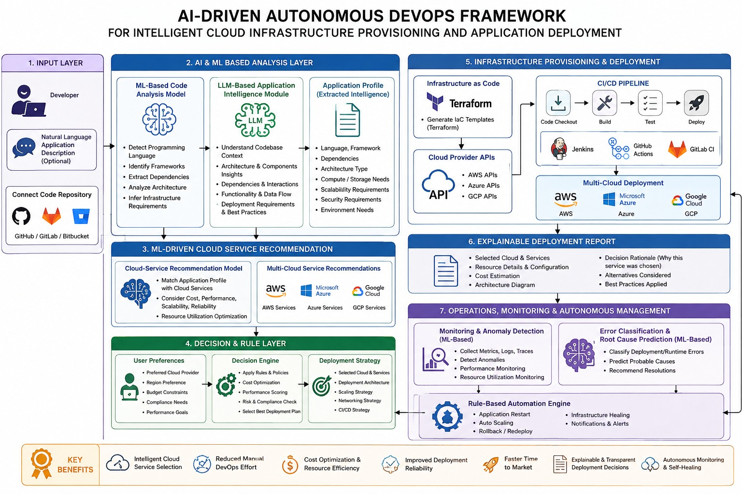
Proposed System Architecture:

Slide 9
Base Paper Link(If any):
https://journals.plos.org/plosone/article?id=10.1371%2Fjournal.pone.0105297&utm_source=chatgpt.com

Slide 10
References:
[1] Humble, J., & Farley, D. (2010). Continuous Delivery: Reliable Software Releases through Build, Test, and Deployment Automation. Addison-Wesley Professional.
[2] Zhang, Q., Fang, C., Xie, Y., et al. (2023). A Survey on Large Language Models for Software Engineering. arXiv:2312.15223.
[3] Hou, X., Zhao, Y., Liu, Y., et al. (2024). Large Language Models for Software Engineering: A Systematic Literature Review. ACM Transactions on Software Engineering and Methodology, 33(8), Article 220.
[4] Patcas, R., & Motogna, S. (2026). An evaluation study of large language models for addressing code quality issues. Empirical Software Engineering, 31, 118.
[5] Abtahi, S. M., & Azim, A. (2025). Augmenting Large Language Models with Static Code Analysis for Automated Code Quality Improvements. arXiv:2506.10330.

Slide 11
THANK YOU

